Slide 1




Colorado Public Health Association
September 24-26, 2024
Keystone Resort
www.publichealthintherockies.com

Slide 2


PHiR
Public Health in the Rockies is the largest statewide public health conference in the region, with over 650 attendees each year.
PHiR is brought to you by the
Colorado Public Health​ Association (CPHA).​
Vision​
Optimal health for all Coloradans.​
Mission​
To educate, develop and galvanize the Colorado public health community.
ATTENDEES INCLUDE:
  Governmental Local & State Public Health Professionals
  Local Public Health Officials​
  Community Partners​
  Physicians​
  Policy Professionals​
  State Public Health Officials​
  Researchers​
  Environmental Health Professionals​
  Public Health Nurses Students​
  Health Specialists/Coordinators​
  Public Health Educators​
  Medical Providers

Slide 3

Sustainability
Sustainability is incredibly important to us. You will notice a new and improved Sponsor & Exhibitor Prospectus that has eliminated tangible items such as notebooks and water bottles and features opportunities to promote your organization that promotes health, wellness, and recycling. If you don't see a sponsorship level that fits you perfectly, give us a call and we can create a customized level for you!
ADDITIONAL OPPORTUNITIES​
To reserve one of these opportunities, or to discuss custom sponsorship options for your​ organization,​ please contact the PHiR Conference Team at info@coloradopublichealth.org.​

Slide 4

General Conference Sponsorhsips

Slide 5

Presenting Sponsor - $12,500
RESTRICTED TO ONE SPONSOR
  Opportunity for a company representative to speak during opening​ remarks (3-5 minutes)​
  Premier location of your choosing in the exhibitor showcase – Includes 6' skirted exhibit table, 2 chairs & waste basket ​
  One complimentary hotel room at the conference hotel for up to three nights​
  Five conference registrations​
  Logo incorporated into all marketing materials, including pre­conference promotional materials (dependent upon the date of commitment)​
  Logo on posters of sponsors and exhibitors​
  Logo on lanyards​
  Recognition on the website with company description, logo, and a link provided by sponsor​
  Company's pop-up displays placed prominently on stage in the main ballroom and/or by the registration area​ during keynote presentations
  First right of refusal for 2025 Presenting Sponsorship

Slide 6

Peak Sponsor - $7,500
RESTRICTED TO TWO SPONSORS
  Opportunity for a company representative to speak during closing​ remarks (3-5 minutes)
  Premier location of your choosing in the exhibitor showcase – Includes 6' skirted exhibit table, 2 chairs & waste basket ​
  Four conference registrations​
  Logo on posters of sponsors and exhibitors​
  Logo on marketing materials​
  Recognition on the website with company description, logo, and a link provided sponsor​
  Recognition as a Peak Sponsor at keynote presentations

Slide 7


Summit Sponsor - $5,500
  Inclusion in exhibitor showcase – Includes 6' skirted exhibit table, 2 chairs & waste basket
  Three conference registrations​
  Logo on posters of sponsors and exhibitors​
  Recognition on the website with company description, logo, and a link provided sponsor​
  Recognition as a Summit Sponsor at keynote presentations
Alpine Sponsor - $3,500
  Inclusion in exhibitor showcase – Includes 6' skirted exhibit table, 2 chairs & waste basket ​
  Two conference registrations​
  Logo on posters of sponsors and exhibitors​
  Recognition on the website with company description, logo, and a link provided by the sponsor

Slide 8

Timberline Sponsor - $2,500
  Inclusion in exhibitor showcase – Includes 6' skirted exhibit table, 2 chairs & waste basket
  One conference registrations​
  Logo on posters of sponsors and exhibitors​
  Recognition on the website with company description, logo, and a link provided sponsor​
Base Camp Sponsor - $1,500
  One conference registrations​
  Logo on posters of sponsors and exhibitors​
  Recognition on the website with company description, logo, and a link provided by the sponsor

Slide 9

Focused Sponsorships

Slide 10


RESTRICTED TO ONE SPONSOR
Public Health Awards Luncheon Sponsor - $7,500
  Sponsorship of a professionally hired MC or speaker
  Company pop-up display placed prominently on the stage​
  Opportunity for a company representative to speak during opening​ remarks (3-5 minutes)​
  Company name incorporated into all awards materials​
  Four conference registrations
  Inclusion in exhibitor showcase – Includes 6' skirted exhibit table, 2 chairs & waste basket ​
  Company representative involved in handing out awards at the ceremony
  Recognition on the website with company description, logo, and a link provided by the sponsor​
  Logo on posters of sponsors and exhibitors​
  Option to provide a gift or marketing material to be distributed on the table during the ceremony
Be a part of our inaugural year of the unveiling of the new CPHA awards! The ceremony is held during the PHiR conference and draws 400-500 participants to socialize and celebrate the top contributors to public health from 2024. ​

Slide 11

Coffee Ticket Sponsor - $5,500
RESTRICTED TO ONE SPONSOR
Your sponsorship will provide one drink ticket per attendee to be used at the on-site cafe for a complimentary specialty beverage of their choice.
  10 additional tickets for sponsor to pass out at their choosing
  Logo on drink tickets
  Two conference registrations​
  Logo on posters of sponsors and exhibitors​
  Recognition on the website with company description, logo, and a link provided sponsor​

Slide 12


Wellness Sponsor
$4,500
RESTRICTED TO TWO SPONSOR
  Inclusion in exhibitor showcase – Includes 6' skirted exhibit table, 2 chairs & waste basket ​
  Sponsorship signage at wellness sessions
  Option to provide a promotional item (provided by sponsor) given to all participants in wellness activities​
  Option to lead or suggest a wellness session
  Two conference registrations​
  Logo on posters of sponsors and exhibitors​
  Recognition on the website with company description, logo, and a link provided by the sponsor

Slide 13


Photography Sponsor
$3,500
RESTRICTED TO ONE SPONSOR
Your logo will appear on all the pictures of the conference that we post on the PHiR website.​
  Two conference registrations​
  Logo on posters of sponsors and exhibitors​
  Recognition on the website with company description, logo, and a link provided by the sponsor

Slide 14

WI-FI SPONSOR $2,500
RESTRICTED TO ONE SPONSOR
Wi-Fi access will be available for all attendees and the Wi-Fi sponsor will have a customized Wi-Fi network and password and a URL link to the your company homepage once successfully logged in.
  Custom Wifi landing page
  Company name as password
  Two conference registrations​
  Logo on posters of sponsors and exhibitors​
  Recognition on the website with company description, logo, and a link provided by the sponsor

Slide 15

Breakfast Sponsor
$1,500
Lunch Sponsor
$1,500
RESTRICTED TO TWO SPONSORS
RESTRICTED TO TWO SPONSORS
  One conference registration​
  Signage on the meal table​
  Verbal recognition of company during morning announcements​
  Logo on posters of sponsors and exhibitors​
  Recognition on the website with your logo and link
  One conference registration​
  ​Signage on the meal table​
  Verbal recognition of company during morning announcements​
  Logo on posters of sponsors and exhibitors​
  Recognition on the website with your logo and link

Slide 16

Independent Consultant Corner - $500
NEW IN 2024!
RESTRICTED TO SIX SPONSORS
We are excited to announce the new addition of our independent consultant corner at the 2024 PHiR Conference! This offering is a more affordable option for contractors in the public health space. We will create a separate corner outside of the exhibit hall for these sponsors on Wednesday, September 25th. We will provide signage, a small round table with table cloth & one chair. It will also include the additional benefits below.
  One Wednesday Only conference registration​
  Opportunity to upgrade to one full conference registration for an additional $200
  Logo on posters of sponsors and exhibitors​
  Recognition on the website

Slide 17

Recycle Sponsor $550
Tote Bag Sponsor $750
RESTRICTED TO THREE SPONSORS
RESTRICTED TO ONE SPONSOR
  Logo on all of the recycle bins throughout the facility​
  Logo on the badge recycle basket​
  Logo on the poster of sponsors and exhibitors​
  Recognition on the website with company logo and link
  Sponsor provides the tote bags with sponsor logo prior to the start of the conference​
  Logo on the poster of sponsors and exhibitors​
  Recognition on the website with company logo and link
Sanitation Station Sponsor $550
RESTRICTED TO THREE SPONSORS
  Logo on all sanitizing stations throughout the facility​
  Logo on the poster of sponsors and exhibitors​
  Recognition on the website with company logo and link
Pen Sponsor $750
RESTRICTED TO ONE SPONSOR
Scholarship Sponsor $350
  Sponsor provides the pens with sponsor name/logo prior to the start of the conference​
  Logo on the poster of sponsors and exhibitors​
  Recognition on the website with company logo and link
UNLIMITED
  Your sponsorship will help provide a scholarship for an attendee to attend PHiR
  Recognition on the website with company name

Slide 18

Exhibitor Showcase

Slide 19

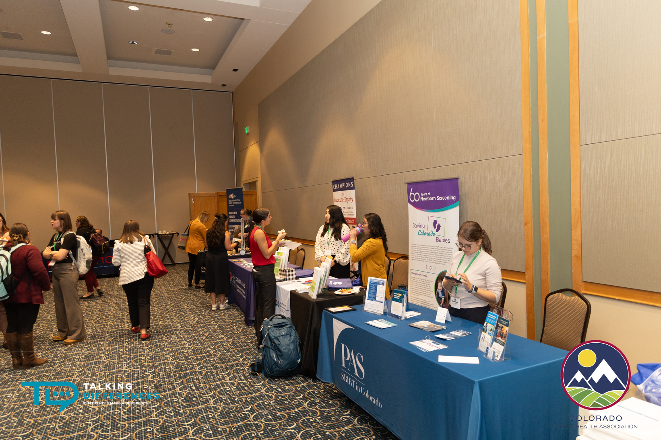
Exhibitor Showcase
The Exhibitor Showcase will be located in the Keystone Conference Center.​ Exhibitor tables and networking will be open from 9am - 5pm, September 24 & 26, 2024.​
INCLUSION IN THE SHOWCASE INCLUDES
  Networking with over 650 attendees from public health and other diverse backgrounds​
  Your logo will appear on the conference website and in all marketing​ & communications​
  Logo on posters of sponsors and exhibitors​
  Conference registrations​
  Includes 6' skirted exhibit table, 2 chairs & waste basket
  Premiere Exhibitors Only:
    One use of attendee list pre or post-conference to email all attendees (designed by you and sent by CPHA)
    Premiere Exhibitors Only will receive 50% off one additional registrant)

Slide 20
Exhibitor Showcase
Premier
BEGINNING JULY 12, 2024: ALL EXHIBITOR PRICING WILL INCREASE BY $250​
NON-PROFIT $1,550
FOR-PROFIT $1,850​
Silver
Bronze
  Includes benefits on previous page
  Two conference registrations​
  Option of one additional registration at 50% off​
  One use of attendee list pre or post­ conference to email​ attendees (designed by you and sent by CPHA)
NON-PROFIT $1,250
FOR-PROFIT $1,550 ​
NON-PROFIT $850
FOR- PROFIT $1,250
  Includes benefits on previous page
  Two conference registrations​
  Includes benefits on previous page
  One conference registration​

Slide 21



For More Information
WWW.PUBLICHEALTHINTHEROCKIES.ORG
INFO@COLORADOPUBLICHEALTH.ORG
303-339-0391

